Slide 1
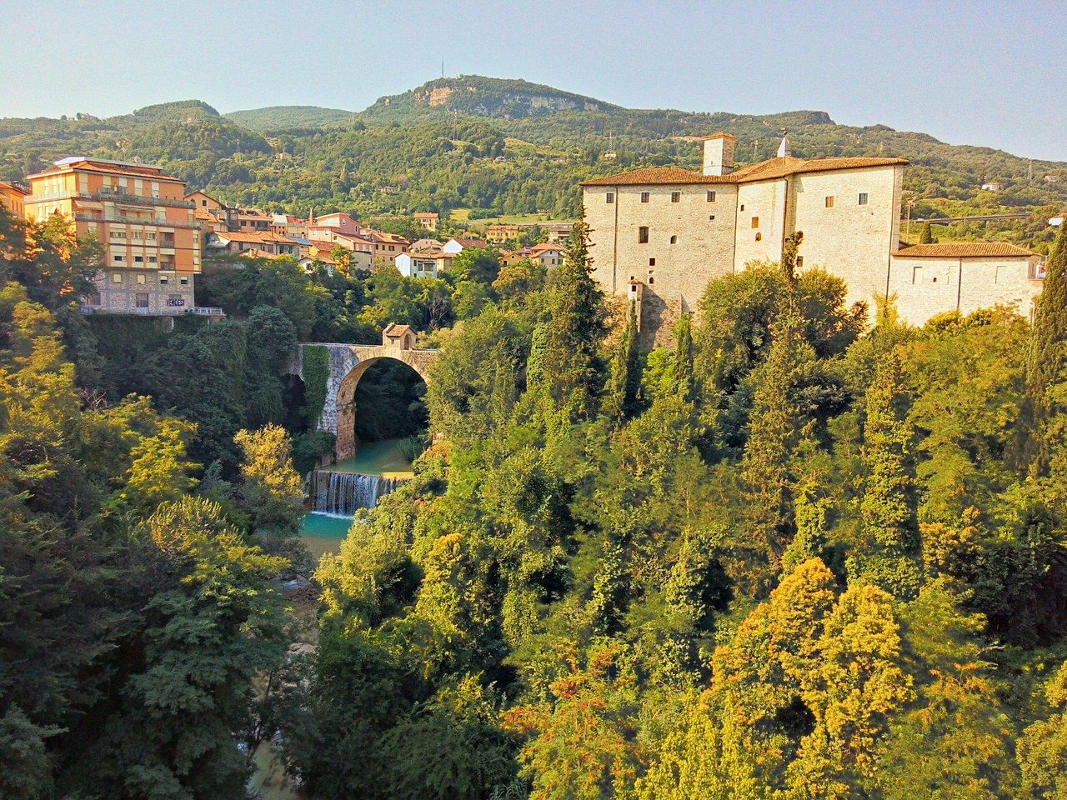

From Data to Insights:
Understanding Tourist Behavior for Ascoli Piceno
Thesis Defense for the Master’s Degree in Data Science for Economics
Presented by: Franco BONIFACINI
Supervisor: Prof. Massimo ALIBERTI
Co-Supervisor: Gioriga FERRANTI
December 2025

Slide 2

Table of Content
TEXT
TEXT
TEXT
Franco BONIFACINI | DSE Thesis Defense
2

Slide 3
INTRODUCTION

Slide 4

Context
Tourism accounts for 7% of global economy.
Global Scale
Franco BONIFACINI | DSE Thesis Defense
4

Slide 5
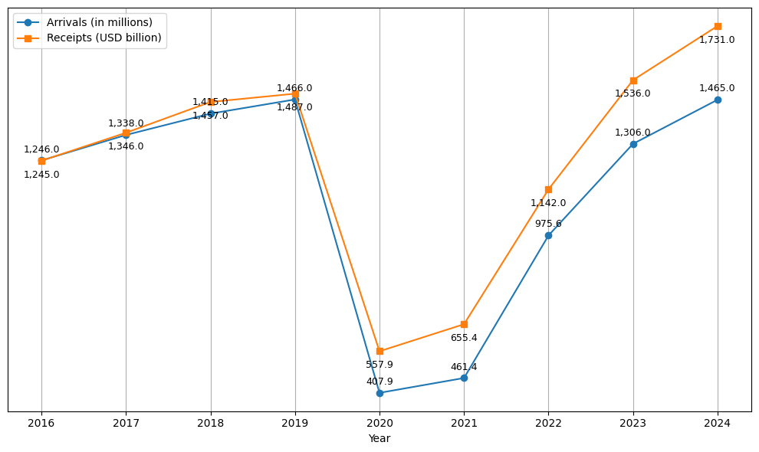
Context
Tourism accounts for 7% of global economy.
Covid-19 effect: -72% the first year
Global Scale
International Tourist Arrivals & Receipts. Source: UNWTO.
Franco BONIFACINI | DSE Thesis Defense
4

Slide 6
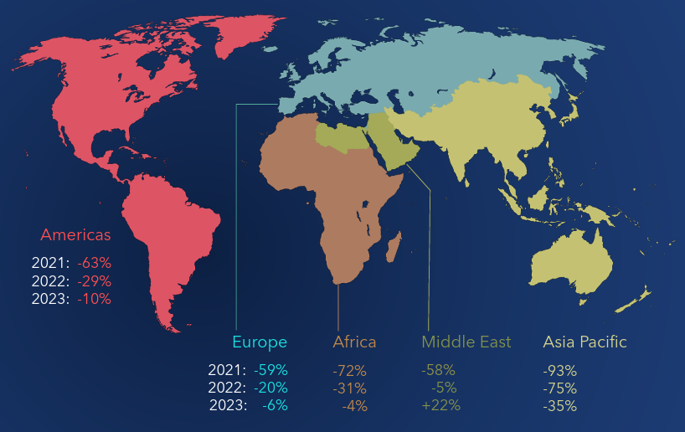
Context
Tourism accounts for 7% of global economy.
Covid-19 effect: -72% the first year
2024 recovery: International arrivals reached 99% of 2019.
Global Scale
International Tourist Arrivals by Region (% change vs 2019). Source: UNWTO.
Franco BONIFACINI | DSE Thesis Defense
4

Slide 7
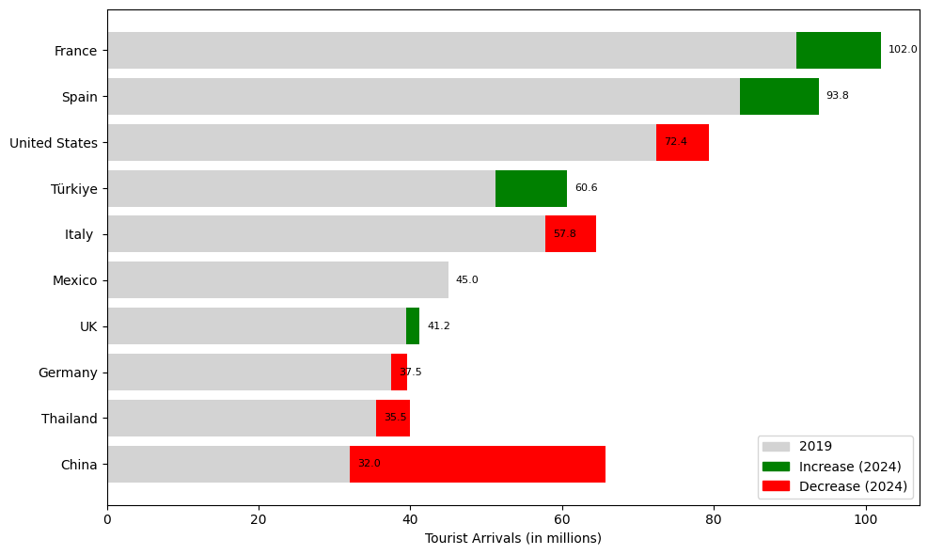

Context
Italy ranks among the world’s Top 5 destinations.
National Scale
Ranking of International Arrivals by Country. Source: UNWTO.
Franco BONIFACINI | DSE Thesis Defense
5

Slide 8
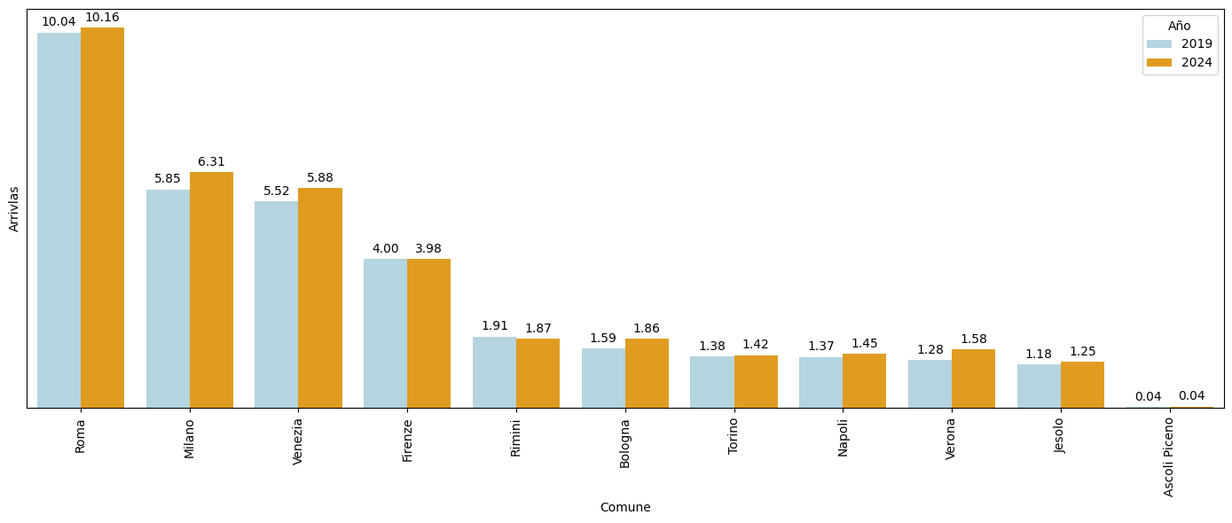
Context
Italy ranks among the world’s Top 5 destinations.
Top 4 cities account for 19% of all tourist arrivals.
National Scale
Rome
Milan
Venice
Florence
Rimini
Bologna
Torino
Naples
Verona
Jesolo
Ascoli Piceno
Total Arrivals by Comuna (2019 vs 2024). Source: ISTAT.
Franco BONIFACINI | DSE Thesis Defense
5

Slide 9
Context
Italy ranks among the world’s Top 5 destinations.
Top 4 cities account for 19% of all tourist arrivals.
National Scale
Declining seasonality: year-round destination.
Franco BONIFACINI | DSE Thesis Defense
5

Slide 10

Context
544th in 2024, with 43,873 arrivals (+18% vs 2019).
National Scale
Ascoli Piceno
Franco BONIFACINI | DSE Thesis Defense
6

Slide 11
Context
544th in 2024, with 43,873 arrivals (+18% vs 2019).
70% of tourists visit only 1% of Italy’s territory.
National Scale
Ascoli Piceno
Residents and Non-Residents Arrivals in Ascoli Piceno (2024). Source: ISTAT.
Franco BONIFACINI | DSE Thesis Defense
6

Slide 12
Context
544th in 2024, with 43,873 arrivals (+18% vs 2019).
70% of tourists visit only 1% of Italy’s territory.
National Scale
Overtourism: Ascoli Piceno’s Opportunity?
Ascoli Piceno
Franco BONIFACINI | DSE Thesis Defense
6

Slide 13







Previous Work
Franco BONIFACINI | DSE Thesis Defense
7

Slide 14
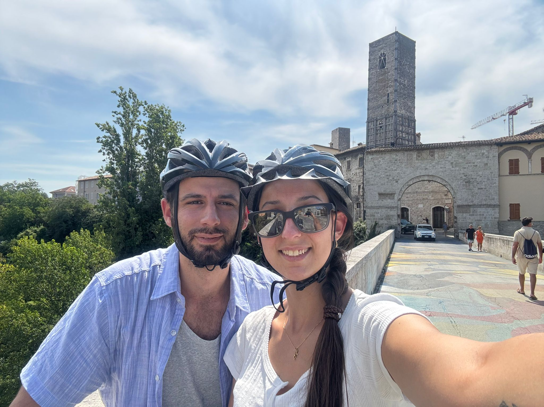

THANK YOU!
Ascoli Piceno

